Slide 1
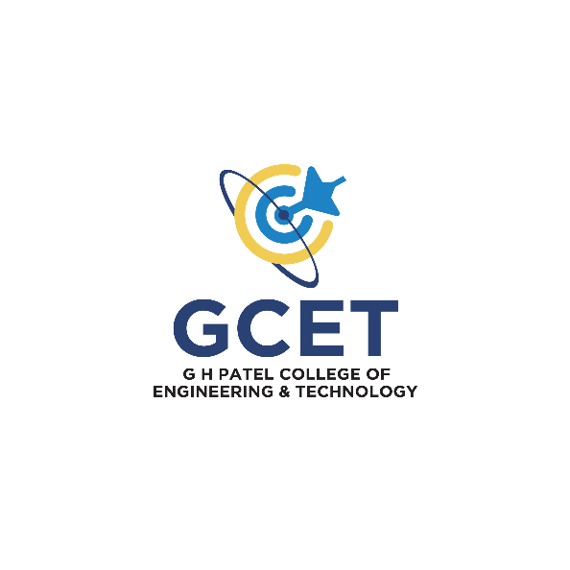
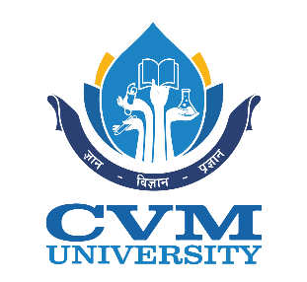
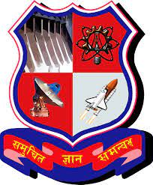
GUJARAT TECHNOLOGY UNIVERSITY (GTU)
G H PATEL COLLEGE OF ENGINEERING & TECHNOLOGY
DEPARTMENT OF COMPUTER ENGINEERING
“3D Printer”
Internal Guide:
Dr. Priyang Bhutt
Prepared by:
Makwana Yash k

Slide 2
INDEX
Project Summary
Purpose
Scope
Advantages
Disadvantages
Type of 3D Printing
3D Printer
Requirment of the System
Softwere
3D printer chart
Live Demo for softwere
Live Demo for Hardwere

Slide 3
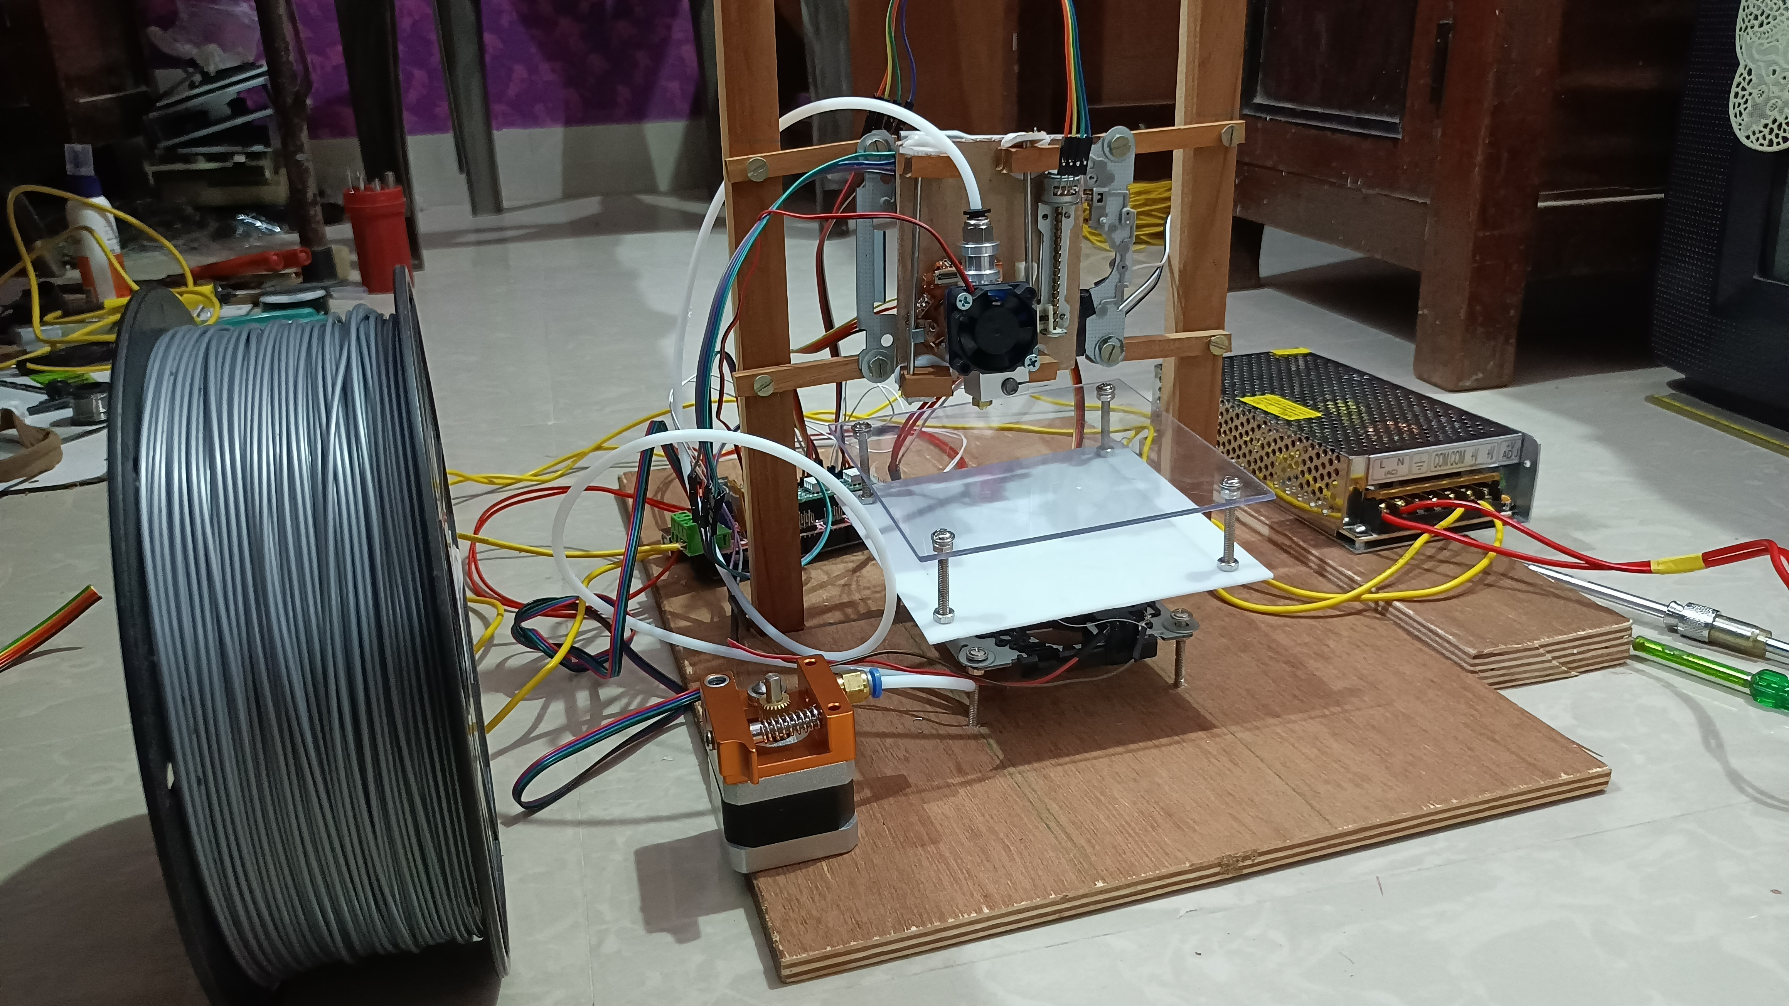
3D Printer
Three-dimensional (3D) printing is an additive manufacturing process that creates a physical object from a digital design.
The process works by laying down thin layers of material in the form of liquid or powdered plastic, metal or cement, and then fusing the layers together.

Slide 4
Purpose
3D Printer is reducing costs and time.
3D printing enables you to produce complex shapes using less material than traditional manufacturing methods.

Slide 5
Scope
3D printer is create a object with the help of 3D design.
The automobile industry is using it to rapidly prototype new car models.
3D printing is used to produce spare and replacement parts in sectors such as aerospace.

Slide 6
Advantages
Flexible Design.
3D printing allows for the design and print of more complex designs than traditional manufacturing processes.
Strong and Lightweight Parts.
Fast Design and Production.
Minimising Waste.
Cost Effective.
Ease of Access.

Slide 7
Disadvantages
Limited Materials
While 3D Printing can create items in a selection of plastics and metals the available selection of raw materials is not exhaustive.
Restricted Build Size.
Reduction in Manufacturing Jobs.
Design Inaccuracies.

Slide 8
Type of 3D Printing
Fused deposition modeling (FDM)
Stereolithography(SLA)
Digital Light Processing(DLP)
Selective Laser Sintering (SLS)

Slide 9
Fused deposition modeling (FDM)
Fused deposition modeling (FDM) is a technology where the melt extrusion method is used to deposit filaments of thermal plastics according to a specific pattern.
3D printing process that uses a continuous filament of a thermoplastic material.

Slide 10
Stereolithography(SLA)
Stereolithography is a 3D Printing process which uses a computer-controlled moving laser beam, pre-programmed using CAM/CAD software.
Stereolithography (SL) is an industrial 3D printing process used to create concept models, cosmetic - rapid prototypes, and complex parts with intricate geometries

Slide 11
Digital Light Processing(DLP)
DLP (Digital Light Processing) is a 3D printing technology used to rapidly produce photopolymer parts
DLP machine uses a projected light source to cure the entire layer at once.

Slide 12
Selective Laser Sintering (SLS)
Selective laser sintering is an additive manufacturing (AM) technology that uses a high power laser to sinter small particles of polymer powder into a solid structure based on a 3D model.
SLS 3D printing has been a popular choice for engineers and manufacturers for decades.

Slide 13
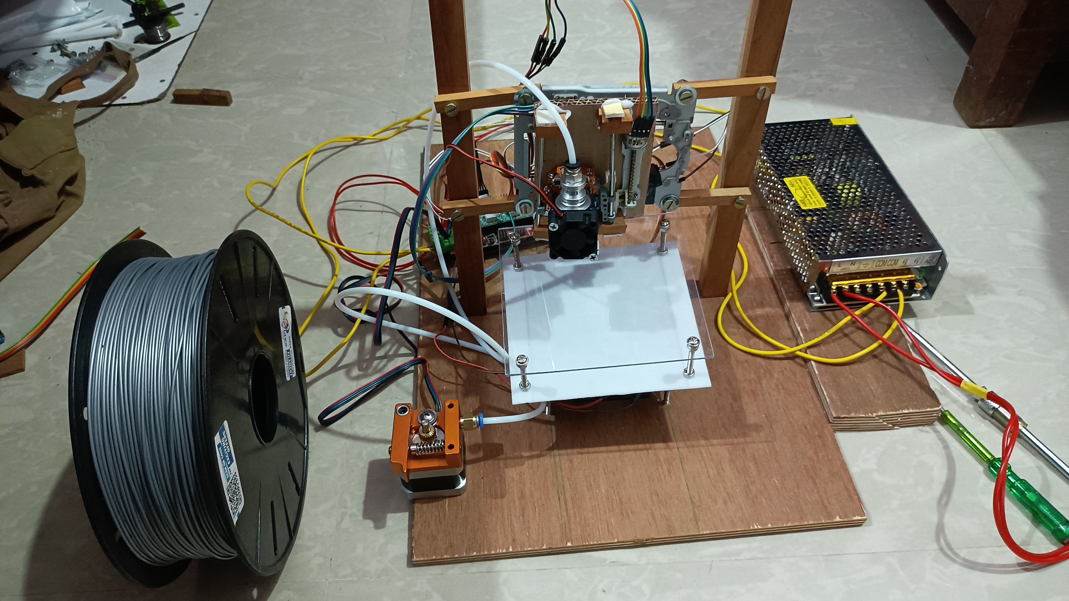
3D Printer

Slide 14
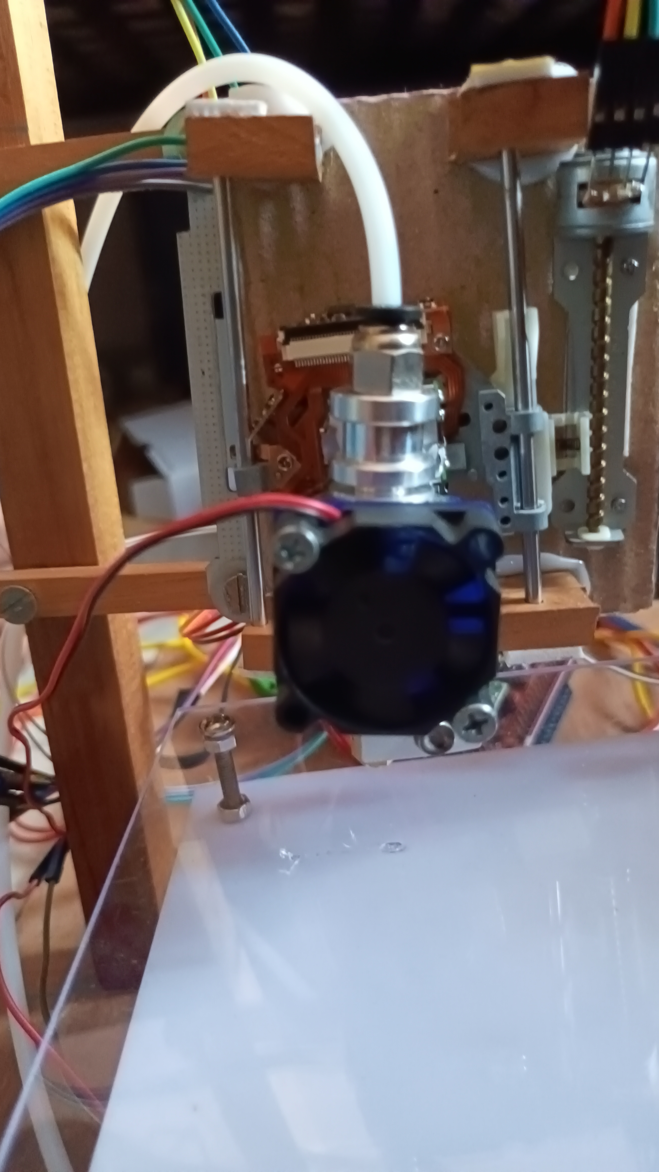
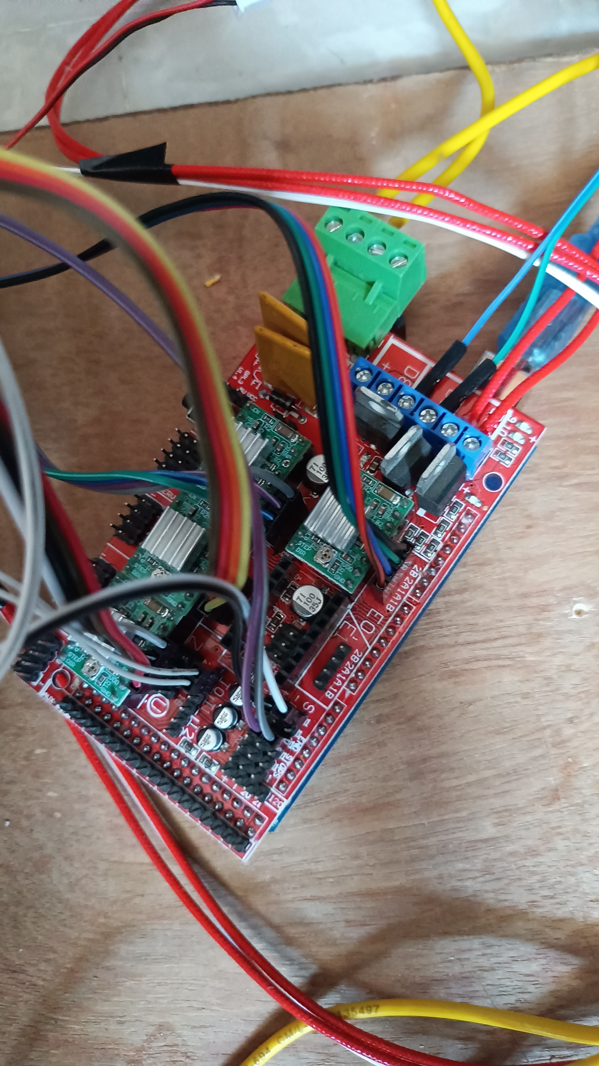
Requirment of the System
Hot End
Ramps1.4
Arduino Mega 2560

Slide 15
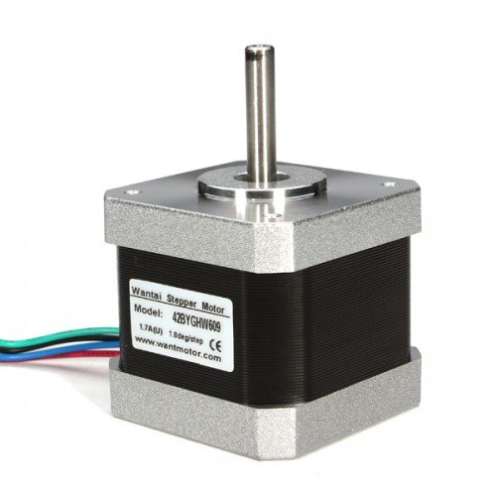
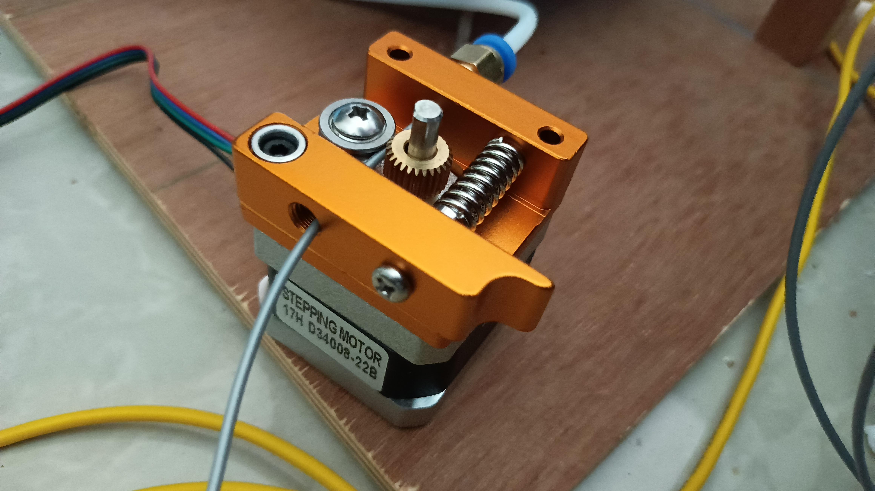
Requirment of the System
Nema 17 Stepper Moter
Extruder Kit

Slide 16
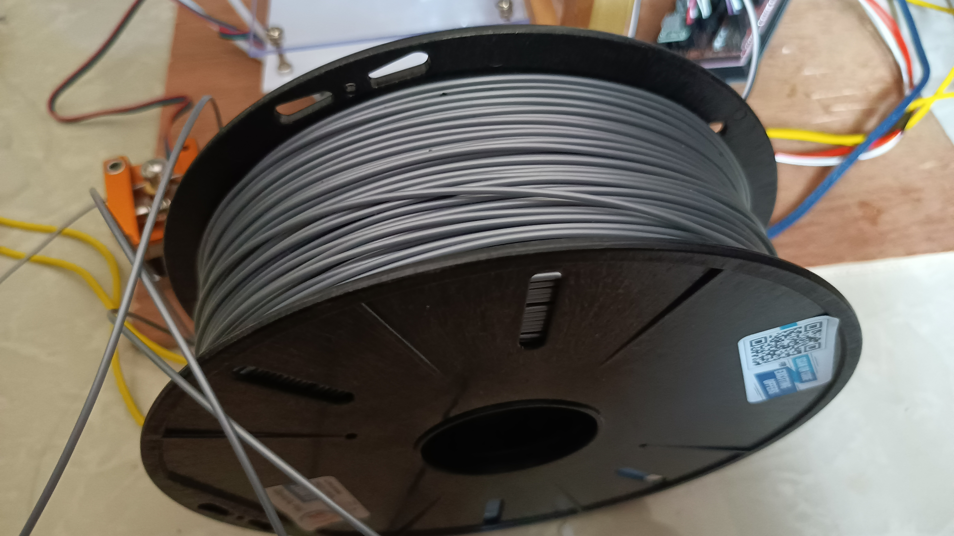
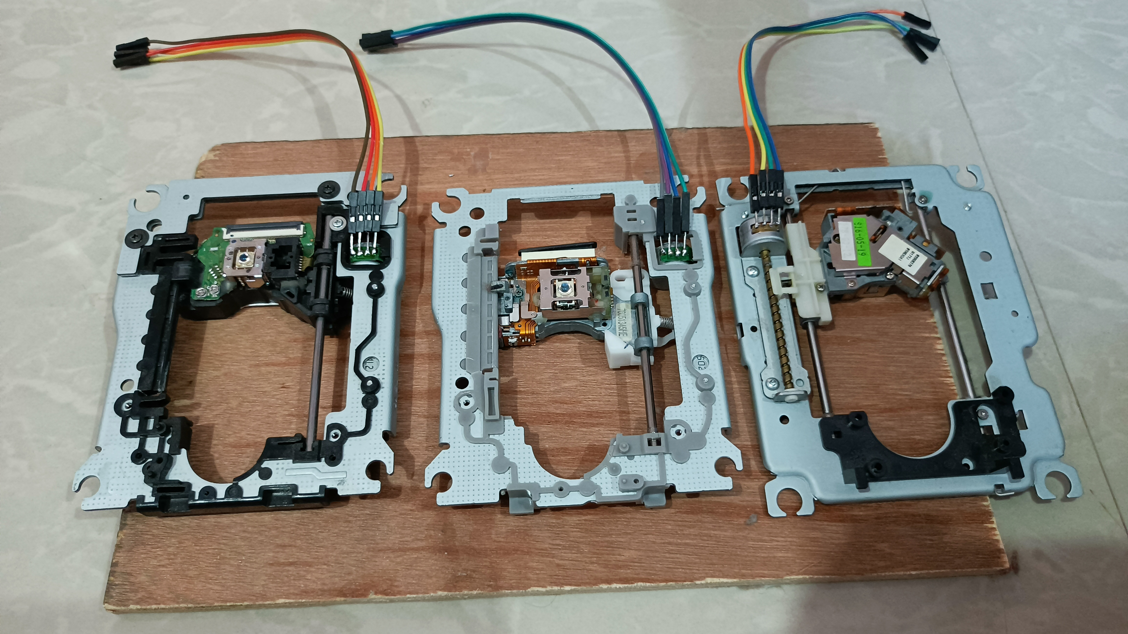
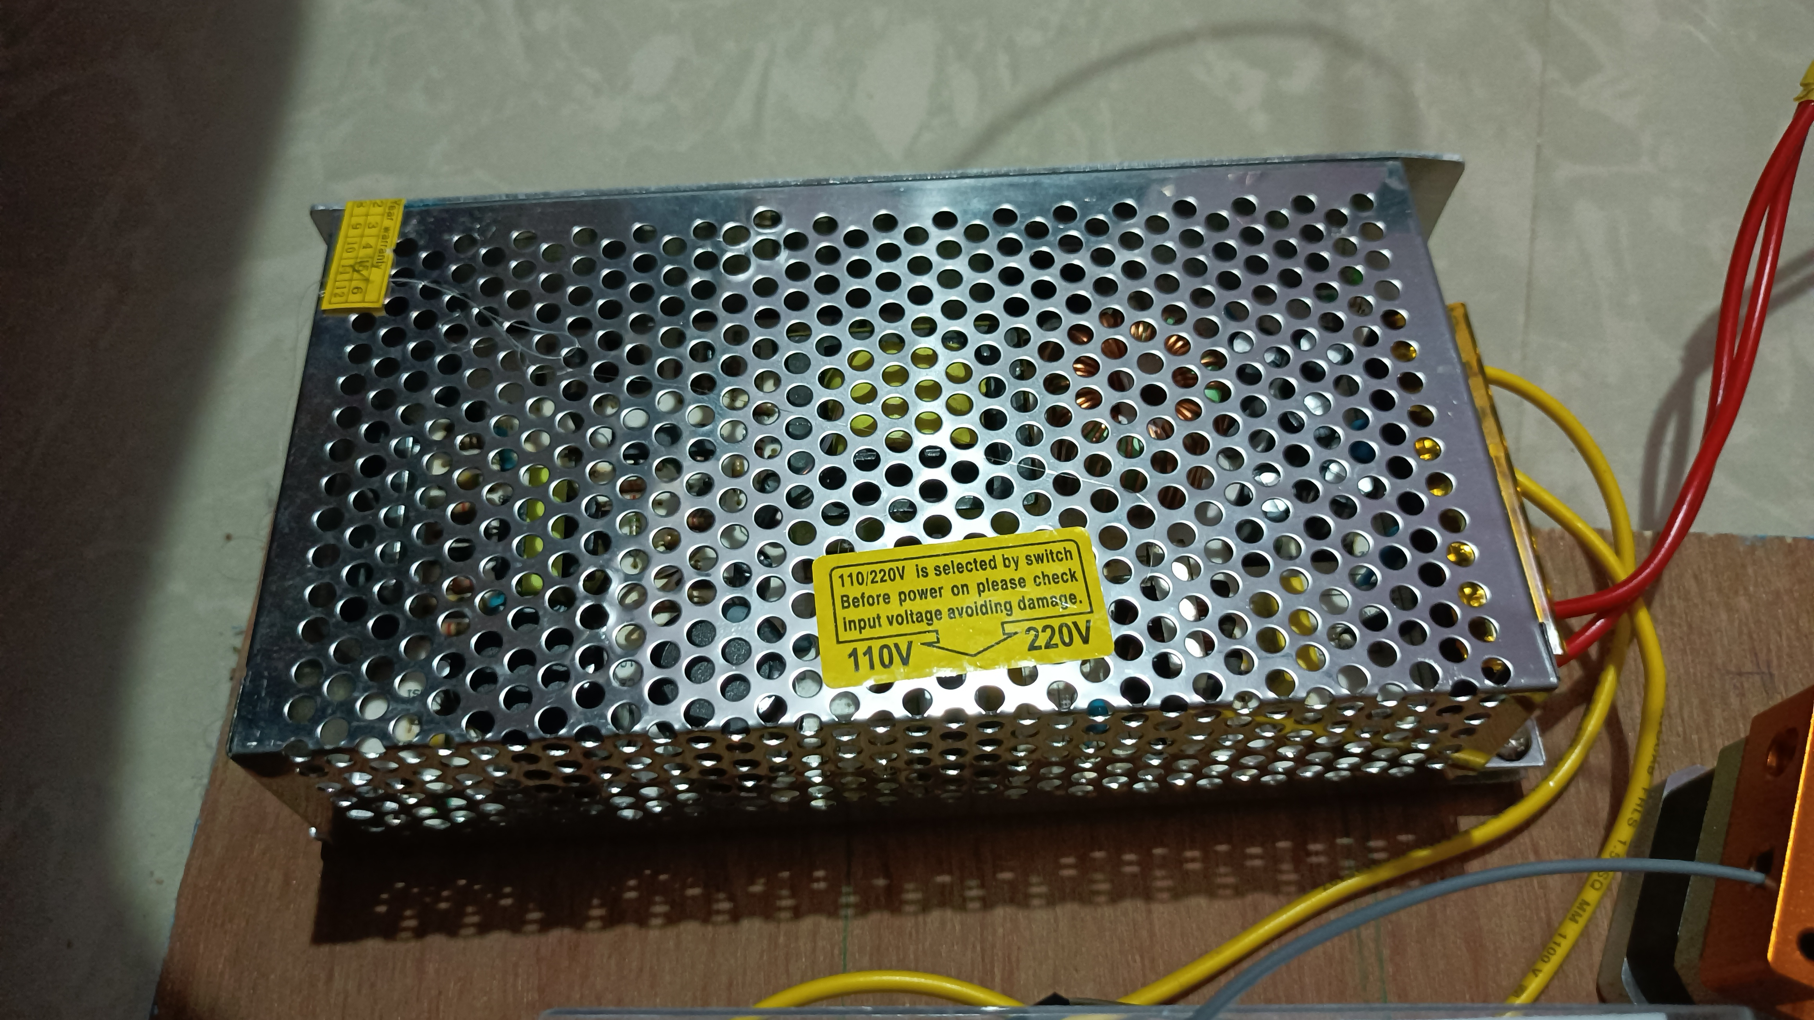
Requirment of the System
Filament
Old DVD Writer
12V Power Supply

Slide 17
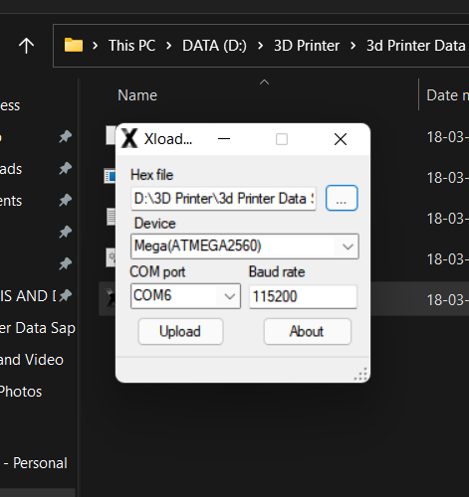
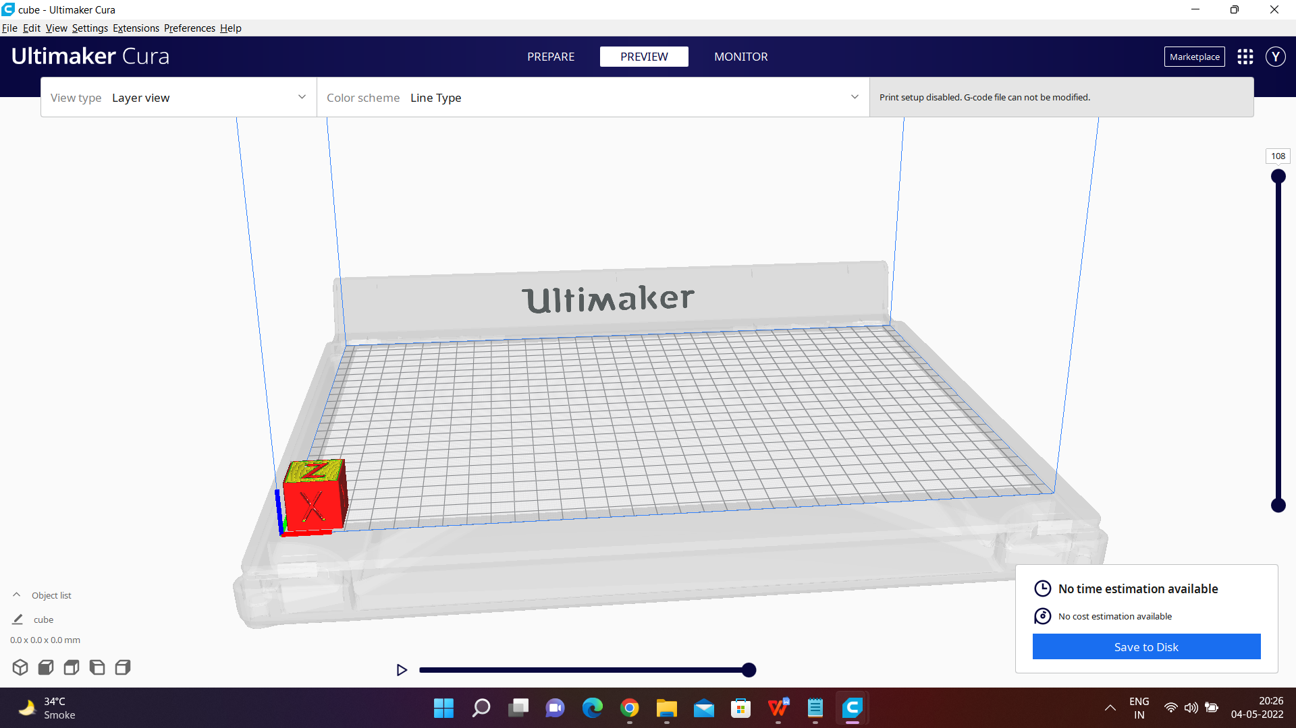
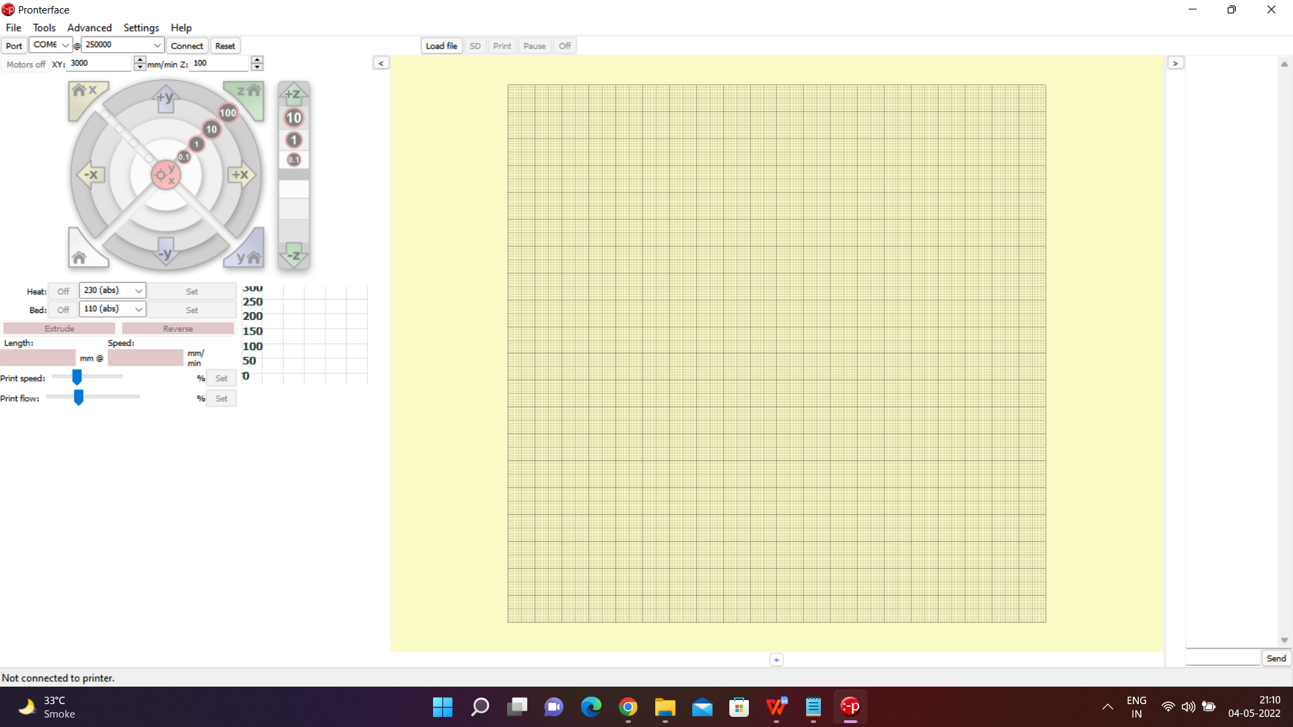
Softwere
Xloader
Cura
Pronterface

Slide 18
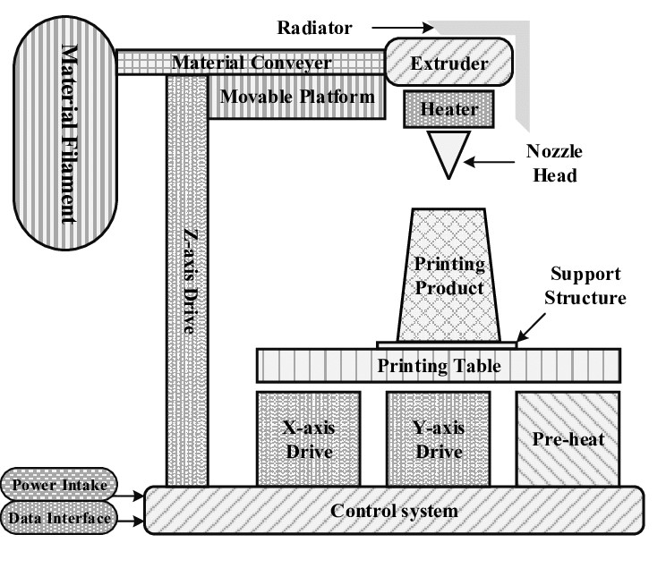
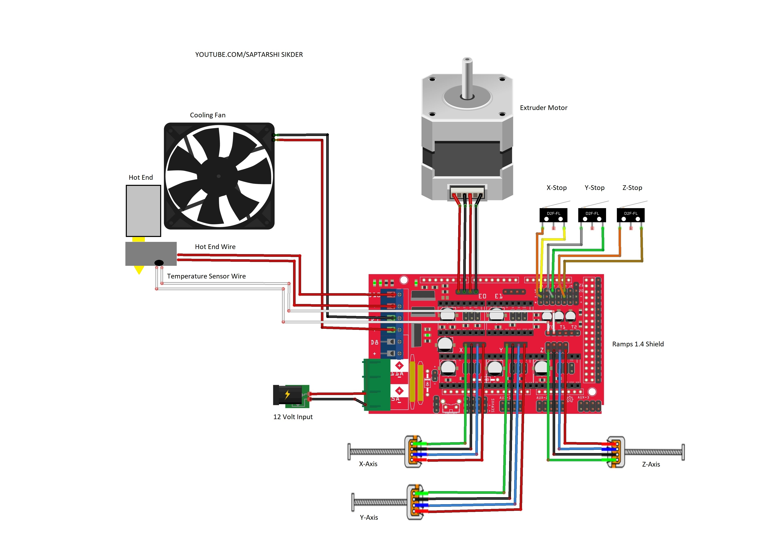
3D printer chart
Details
Connection

Slide 19
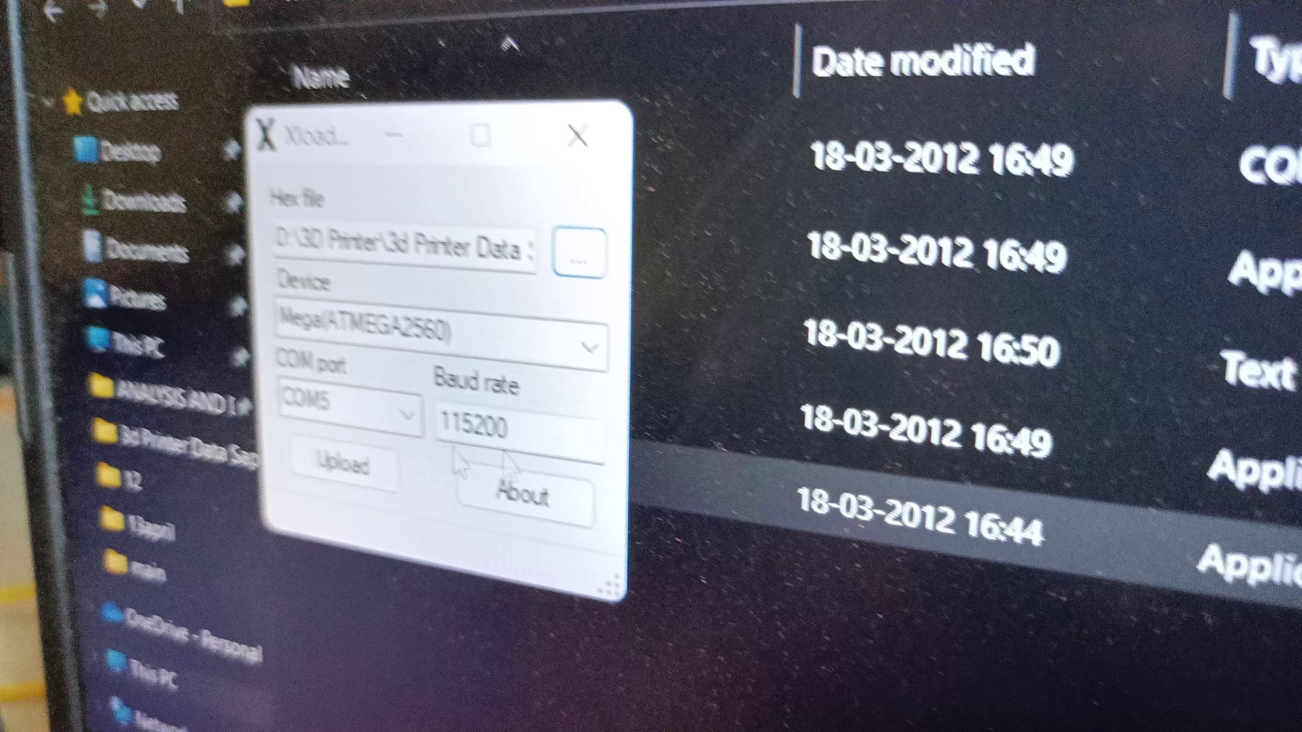
Live Demo for softwere
Xloader

Slide 20
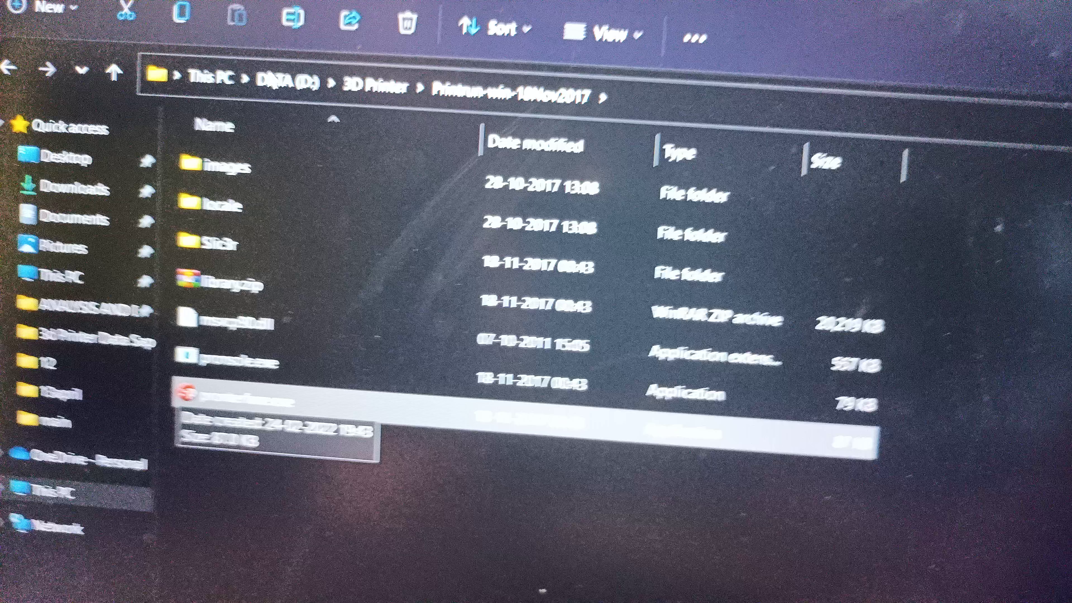
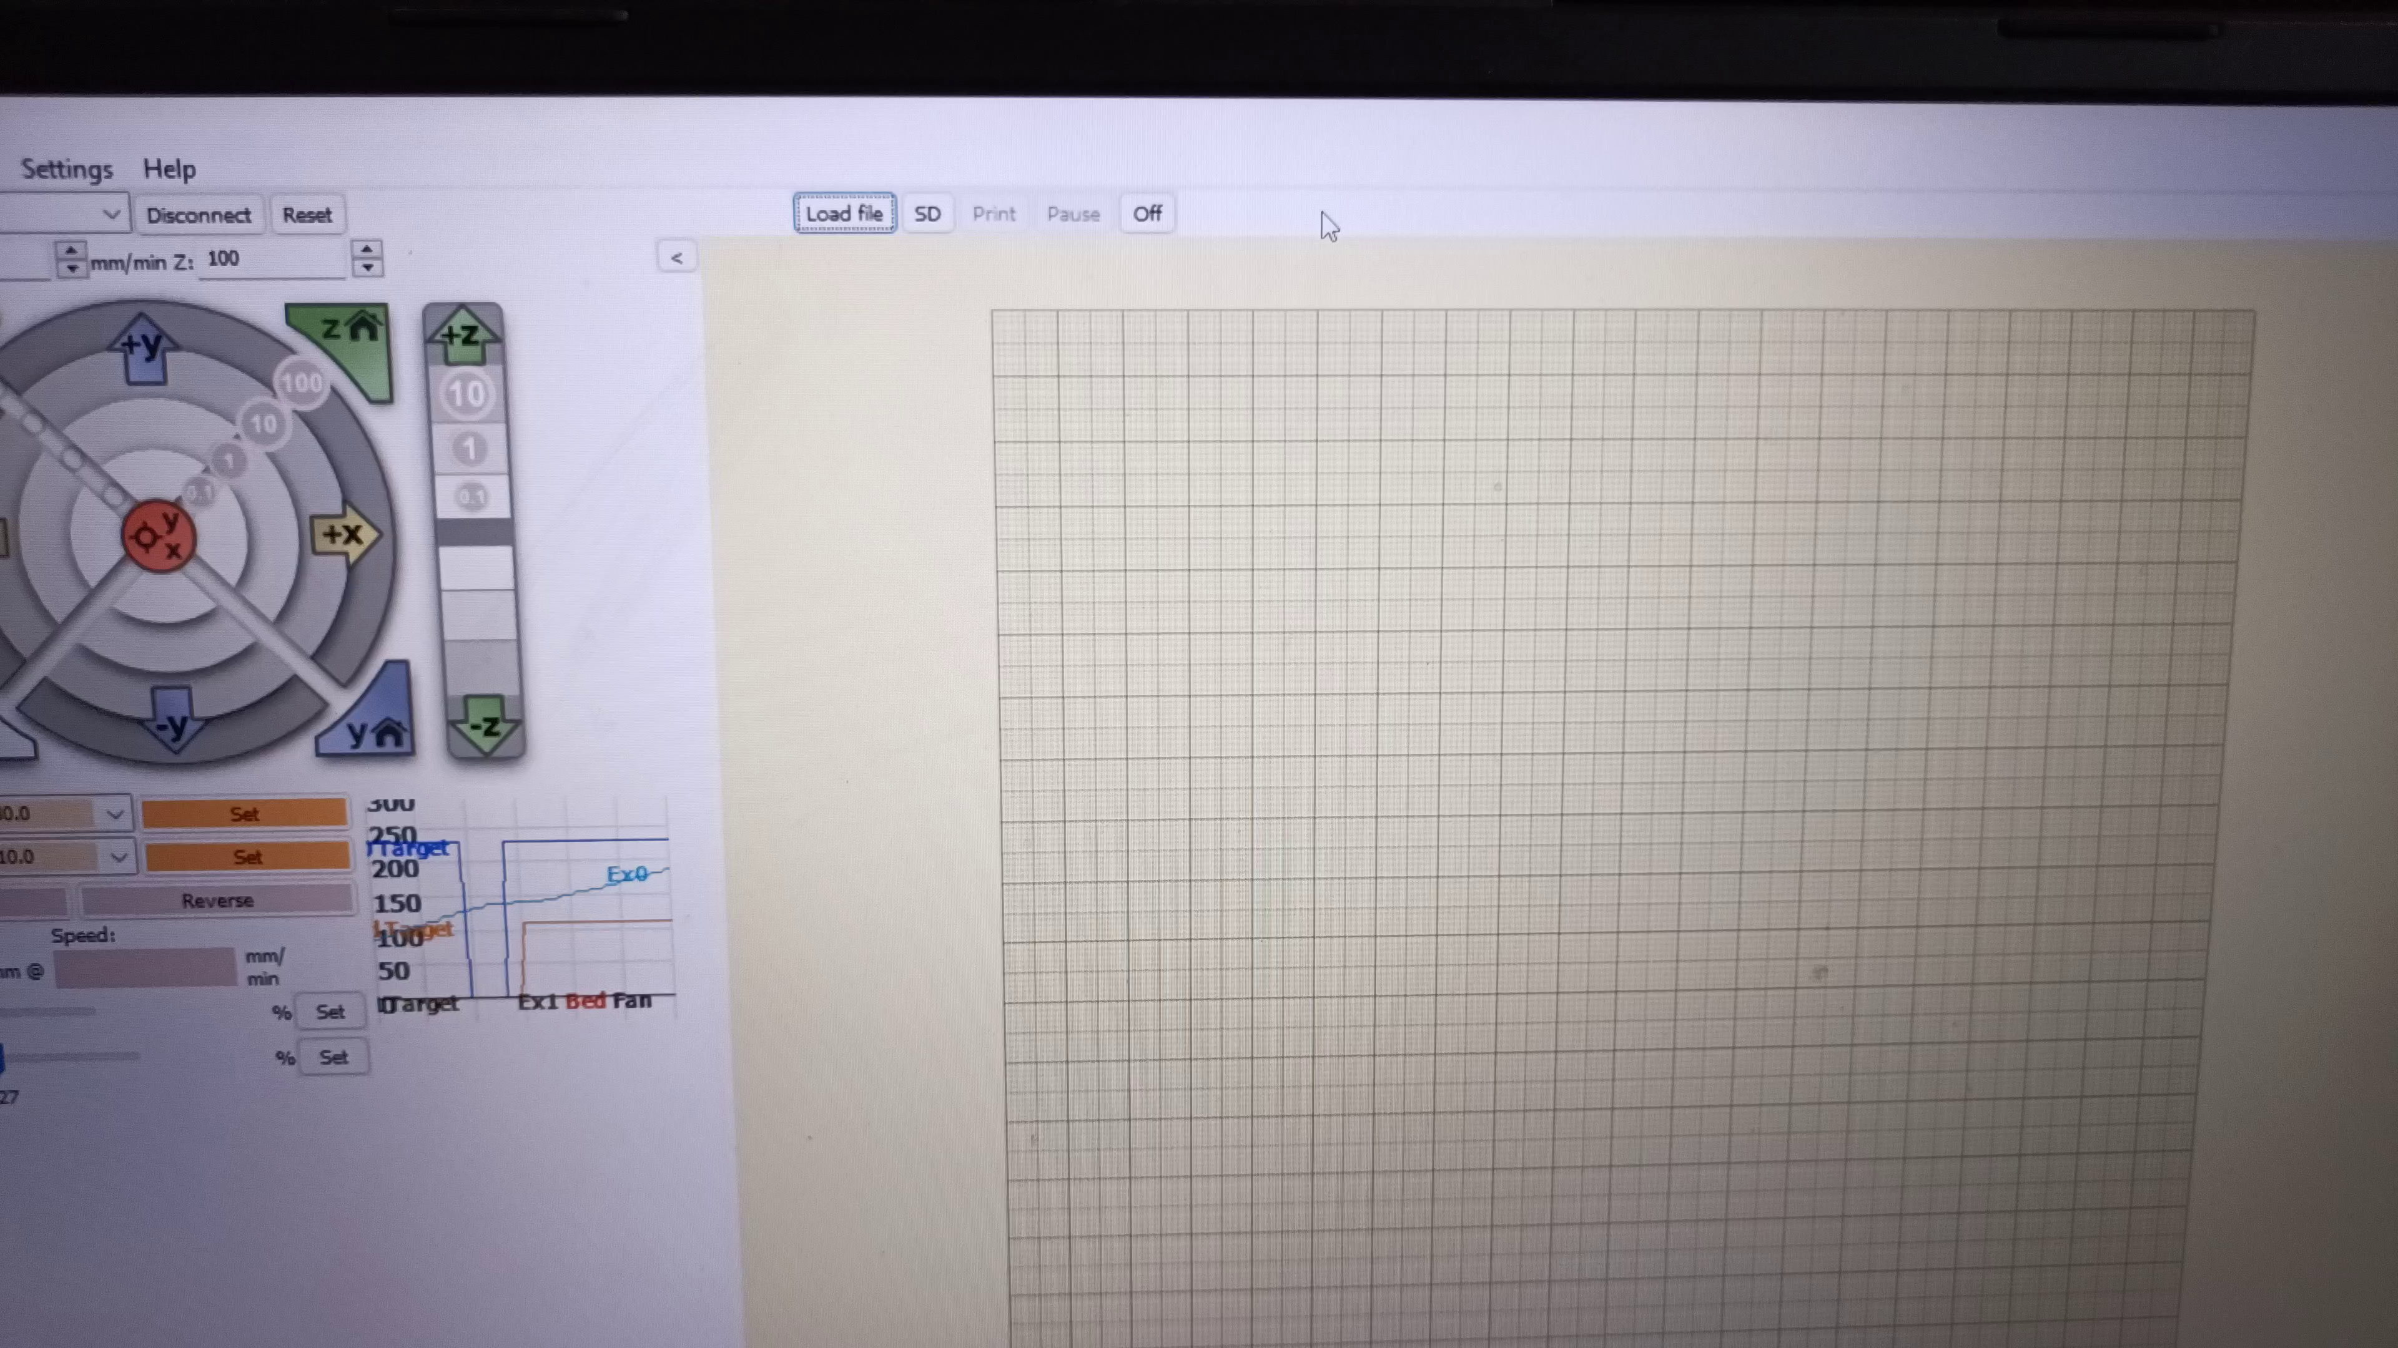
Live Demo for softwere
Add Printer
Add G code

Slide 21
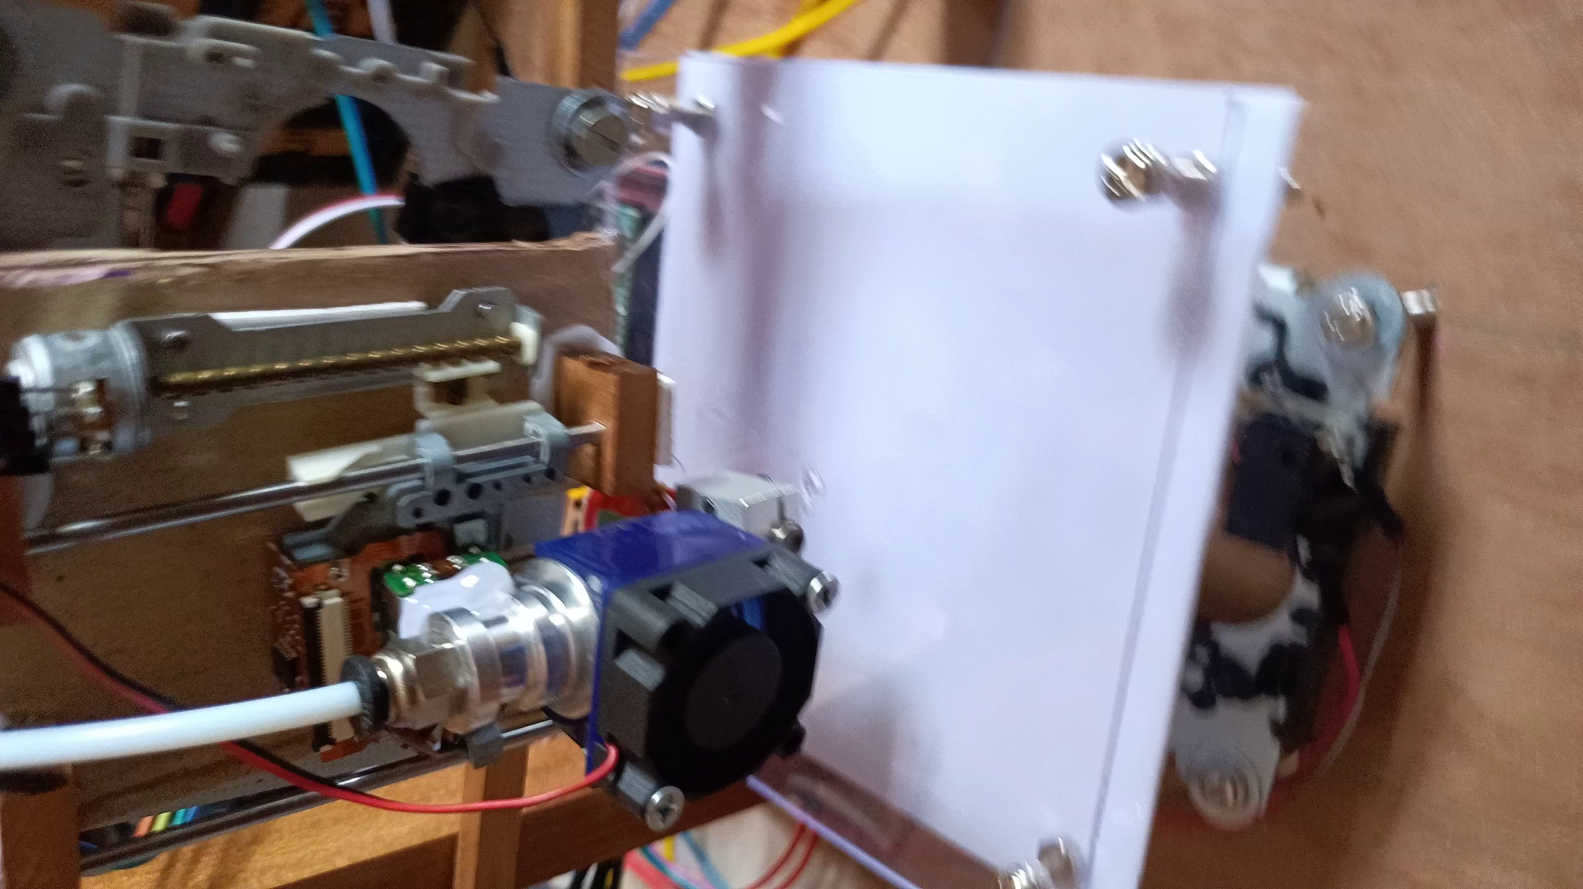
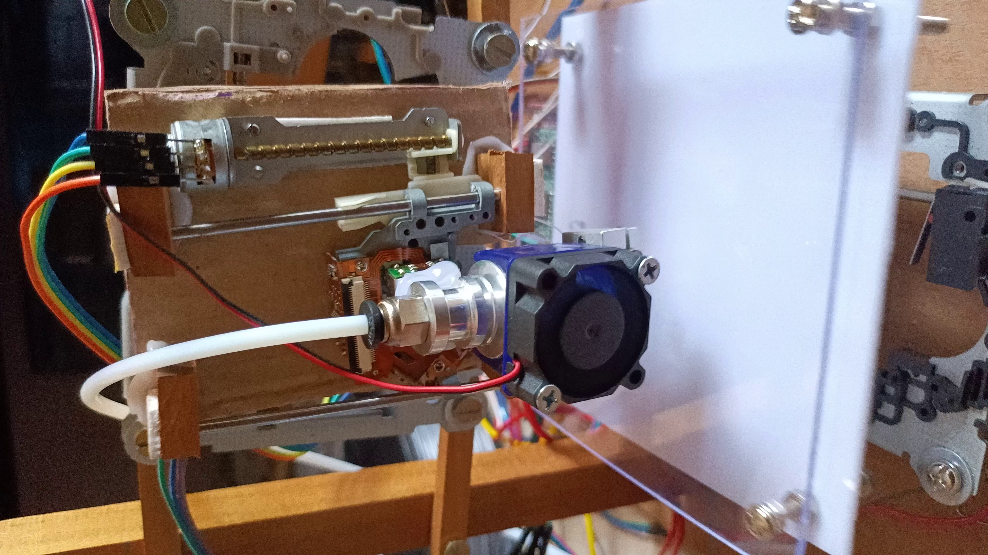
Live Demo Hardwere
X Axis and Y Axis
All parts

Slide 22
CONCLUSIONS
“I conclude that this product create your 3D model, user friendly environment to user, Flexible to use. It is create 3D parts”
3D printer is an advanced manufacturing process used to built physical objects from digital images.
3D printer is highly efficient and time saving & ecofriendly.

Slide 23
Thank You!

